Slide 1
化学发展史
讲课人：AI
Notes:
各位同学好，这里是化学发展史课程。如果与任何问题，可以选择提问。

Slide 2
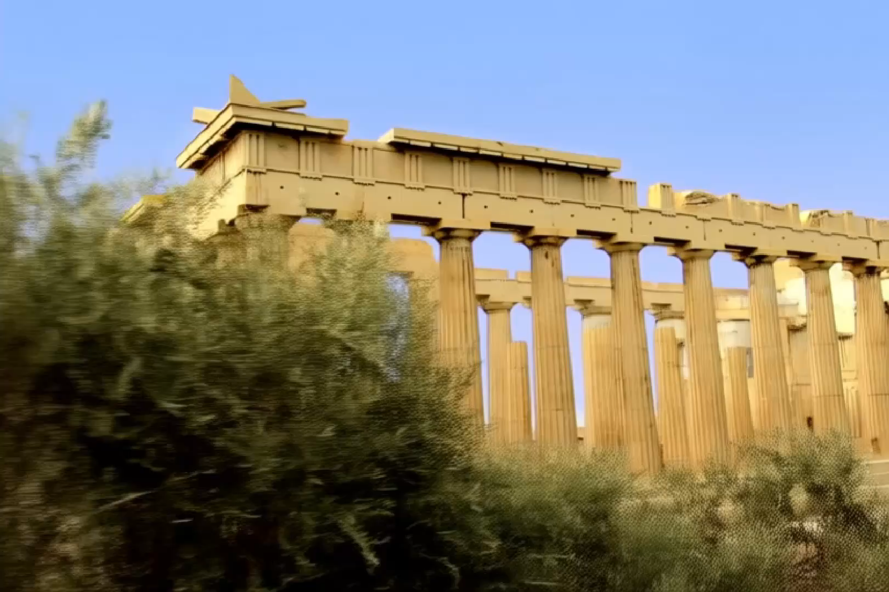
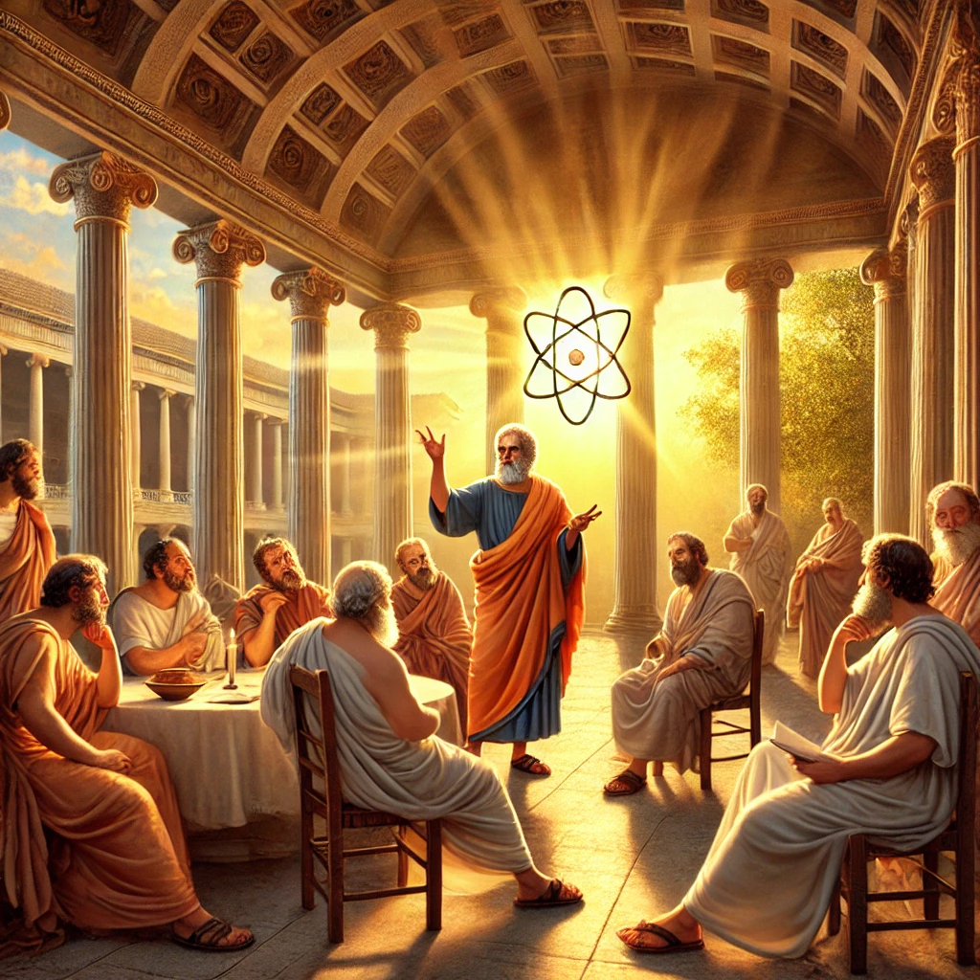
阳光照耀下的古希腊学园，哲学家们在柱廊下讨论自然哲学，德谟克利特向众人阐述原子论的雏形，他用简单的手势比划着原子的形态和运动。
古希腊的先哲们
Scene 1: Ancient Greek Academy Under Sunlight (Character Introduction)
Film Style: Detailed cinematic, high-definition realism.
The camera begins with an Extreme Long Shot, capturing a majestic ancient Greek academy bathed in warm, golden sunlight. Tall marble columns gleam under the clear blue sky, surrounded by olive trees swaying gently in the breeze. A slow Dolly In transitions to a Medium Shot of philosophers dressed in flowing white robes, engaged in animated discussions beneath the columned portico. Soft natural lighting enhances the serenity and timelessness of the scene. The hum of lively chatter and distant bird songs fills the air.
Scene 2: Philosophical Debate Under the Colonnade
Film Style: Detailed cinematic, high-definition realism.
A Tracking Shot follows Democritus as he steps forward among the philosophers, his posture confident yet humble. The camera shifts to a Close Shot as he raises a hand to emphasize a point, his face lit with intellectual fervor. Around him, others nod or stroke their beards thoughtfully, some gesturing in counterarguments. The camera alternates between Over-the-Shoulder Shots of Democritus speaking and wide shots capturing the collective reactions of the group. High contrast lighting plays with shadows, reflecting the depth of their debate.
Scene 3: Explaining the Atom Theory
Film Style: Detailed cinematic, high-definition realism.
The camera settles into a Medium Close-Up of Democritus as he uses fluid, deliberate hand gestures to describe the shapes and movements of atoms. The light shifts subtly, emphasizing his movements. A quick Cut-In Shot captures his hands forming imaginary atomic structures. The scene transitions to a Point-of-View Shot, revealing an imagined visual representation of atoms as floating, moving spheres in the air, subtly rendered in soft golden hues. Soft mood lighting shifts back to reality as the philosophers erupt in intrigue, their faces illuminated with awe.
Notes:
在文明的曙光初照之时，古希腊的先哲们便开始思索物质的本质。德谟克利特提出，世间万物皆由微小且不可分割的原子构成，这一思想虽未经实验证实，却如同一颗闪耀的星辰，在人类对化学的认知长河中点亮了第一缕微光。

Slide 3
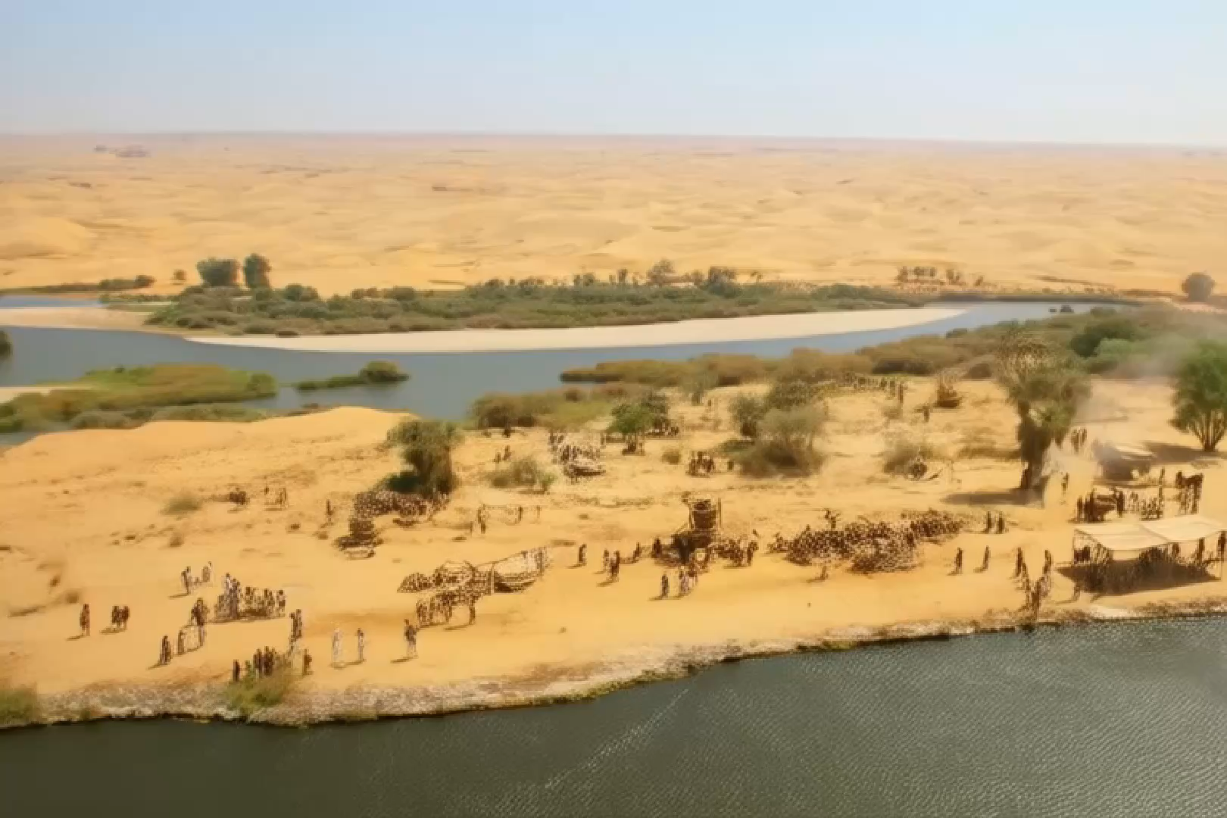
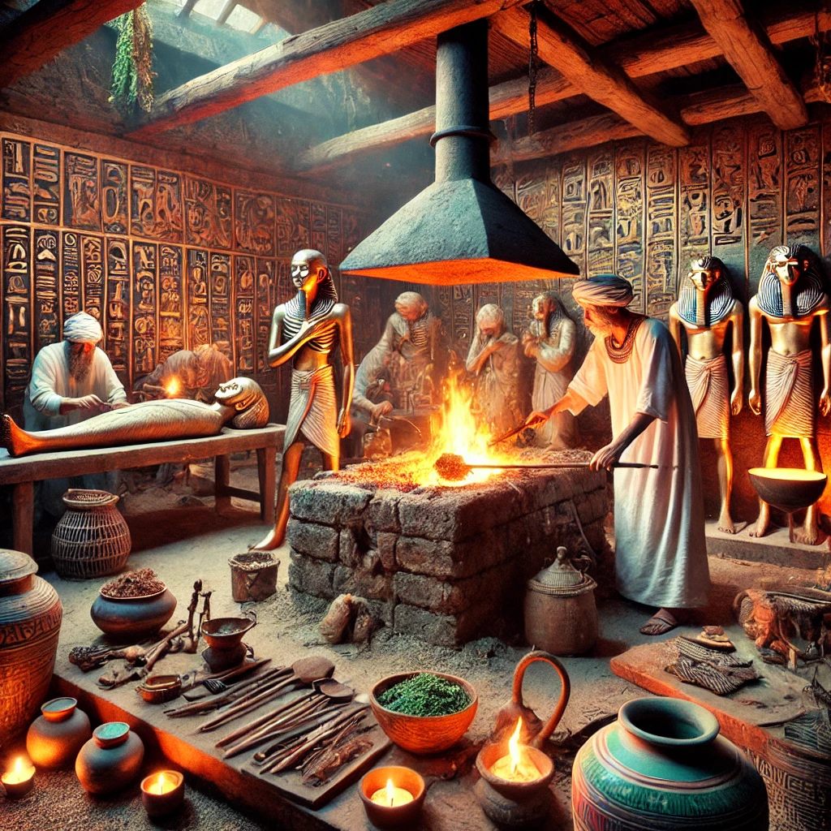
与此同时，在古老的埃及土地上，实用化学已悄然萌芽。埃及人掌握了高超的金属冶炼技术，那些原本沉睡于矿石中的金属，在烈火中被唤醒，成为了工具与饰品的原料。而木乃伊制作过程中对各种物质奇妙特性的运用，更是他们对化学物质初步探索的见证。
古埃及的化学
Scene 1: The Ancient Egyptian Land Awakens (Setting Introduction)
Film Style: Detailed cinematic, high-definition realism.
An Overhead Shot reveals the sprawling, sun-drenched Egyptian desert with the Nile River winding through the landscape. The camera slowly Dollies Down, transitioning to an Extreme Long Shot of a bustling ancient Egyptian settlement. Smoke rises gently from furnaces, contrasting against the brilliant blue sky. Workers in simple linen garments move purposefully between adobe workshops and the riverbank. Golden natural lighting bathes the scene, highlighting the harmony between human activity and the environment.
Scene 2: The Art of Metal Smelting (Action and Process)
Film Style: Detailed cinematic, high-definition realism.
A Close-Up focuses on glowing furnaces, the flames dancing vividly as chunks of ore are fed into the fire. A Medium Shot captures a blacksmith hammering molten metal on an anvil, sparks flying with each strike. The camera switches to a High Angle Shot, revealing tools and decorative trinkets formed from the smelted metal. Soft natural lighting contrasts with the intense glow of the furnace, emphasizing the transformation of raw materials into something purposeful. In the background, faint sounds of rhythmic hammering and crackling fire fill the air.
Scene 3: The Mysteries of Mummification (Exploration of Chemistry)
Film Style: Detailed cinematic, high-definition realism.
Inside a dimly lit chamber, a Tracking Shot follows Egyptian embalmers as they carefully handle jars of aromatic resins and natron. A Close-Up captures hands delicately applying the substances, the rich textures of the materials highlighted under flickering torchlight. The camera pans to a Wide Shot, showing the entire process: the deceased figure surrounded by jars, linen wrappings, and ritual tools. A Point-of-View Shot immerses the audience in the alchemical transformation, as the embalmers marvel at the preservation and transformation of the body. High contrast shadows and the warm glow of torches enhance the mystical atmosphere.
Notes:
与此同时，在古老的埃及土地上，实用化学已悄然萌芽。埃及人掌握了高超的金属冶炼技术，那些原本沉睡于矿石中的金属，在烈火中被唤醒，成为了工具与饰品的原料。而木乃伊制作过程中对各种物质奇妙特性的运用，更是他们对化学物质初步探索的见证。

Slide 4
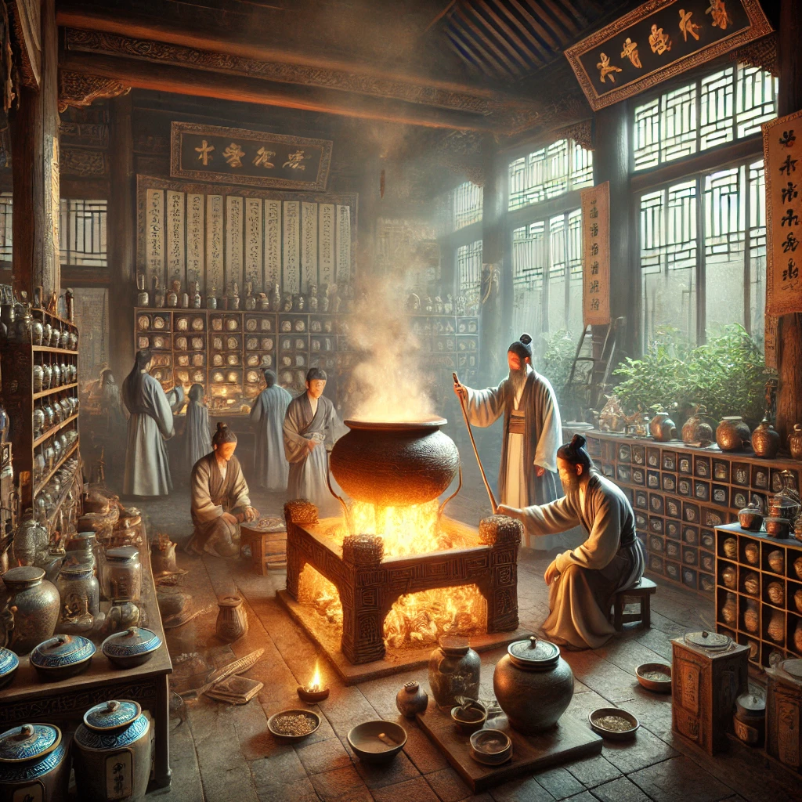
古代中国的炼丹房里，炼丹师们围着熊熊燃烧的丹炉，小心翼翼地添加着各种草药和矿物，丹炉上烟雾升腾，旁边的架子上摆满了瓶瓶罐罐和写满丹方的古籍。
古代中国的化学
Scene 1: The Alchemist's Chamber (Setting Introduction)
Film Style: Detailed cinematic, high-definition realism.
The camera begins with an Extreme Long Shot of a serene ancient Chinese landscape at dusk, transitioning smoothly to a Dolly In through an open window into a dimly lit alchemist’s chamber. Soft, warm lighting highlights the intricate wooden beams of the room. A Medium Shot reveals the central focus: a glowing furnace surrounded by ornate, ancient tools. Smoke curls upward from the danlu (elixir furnace), adding a mystical air. Shelves line the walls, cluttered with jars, vials, and ancient scrolls. The faint crackle of fire and the rustle of robes break the heavy silence.
Scene 2: Around the Furnace (Action and Experimentation)
Film Style: Detailed cinematic, high-definition realism.
A Close-Up focuses on the alchemists' hands delicately sprinkling powdered minerals into the glowing danlu. Sparks fly as the substances react. The camera switches to a Medium Shot of the alchemists in motion, their faces illuminated by the furnace’s fiery glow, brows furrowed in concentration. A Low Angle Shot emphasizes the towering furnace and the swirling smoke that rises above it, symbolizing the blend of science and mysticism. Soft shadows from the flickering firelight dance across the walls, enhancing the room's enigmatic atmosphere.
Scene 3: Mystical Symbols and Ancient Formulas
Film Style: Detailed cinematic, high-definition realism.
A Tracking Shot pans across a shelf filled with ceramic jars labeled with ancient Chinese characters, transitioning to a Close-Up of an open ancient text on a wooden table. The pages are filled with intricate diagrams and handwritten formulas. The camera shifts to a Point-of-View Shot, immersing the viewer in the perspective of an alchemist reading the text. As smoke from the furnace rises in the background, the room fills with an eerie, otherworldly glow, suggesting the powerful transformation happening within the danlu. High contrast lighting emphasizes the interplay of light and shadow, evoking a sense of secrecy and discovery.
Notes:
远在东方的华夏大地，炼丹术盛行。炼丹师们怀着对长生不老的追求，在丹炉中混合着各类物质，虽未炼出仙丹，却意外地发现了许多化学反应，火药便是这漫长探索旅程中的意外惊喜。这一发明，不仅改变了战争的格局，更在日后推动了化学发展的进程。

Slide 5
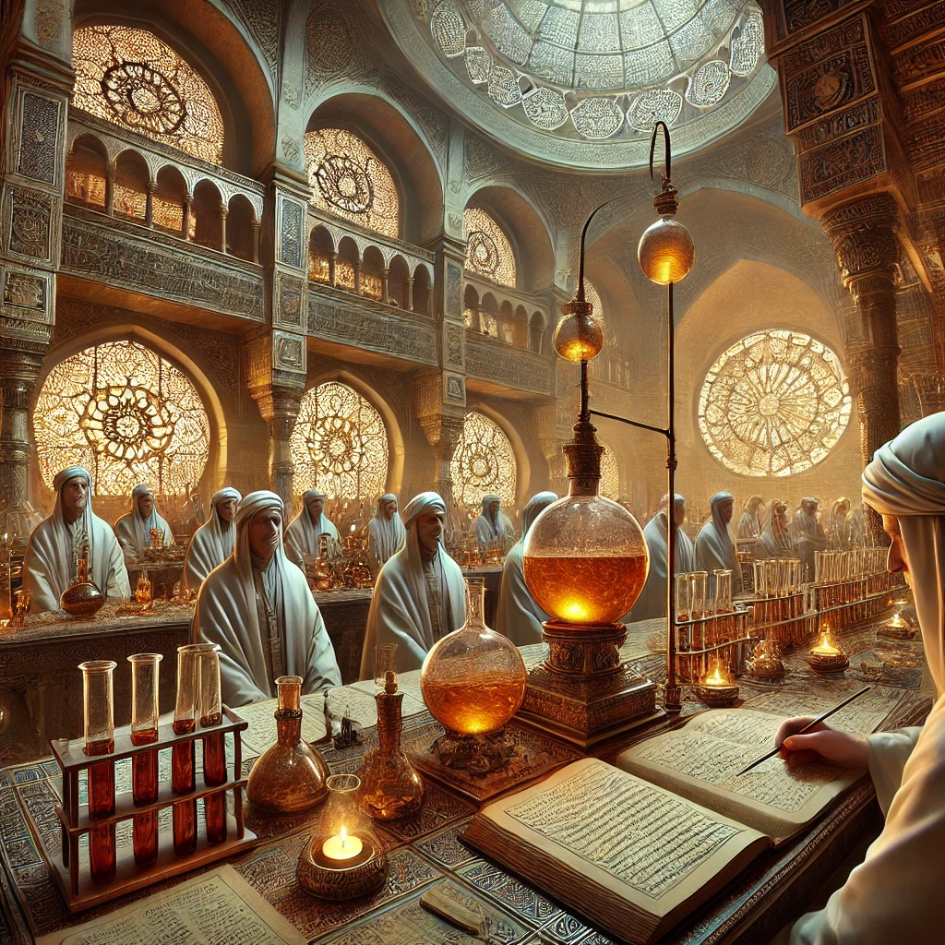
Scene 1: The Medieval Arab Alchemy Laboratory (Setting Introduction)
Film Style: Detailed cinematic, high-definition realism.
The camera opens with an Overhead Shot of a grand medieval Arab city at dusk, transitioning to a Dolly In through a narrow stone archway into a softly illuminated alchemical laboratory. A Wide Shot reveals scholars in flowing robes gathered around an elaborate wooden table. Lanterns cast a golden glow over shelves filled with intricate glassware and handwritten manuscripts in elegant Arabic script. The warm lighting contrasts with the cold stone walls, creating a balance between knowledge and mystery.
Scene 2: Observing the Distillation Process (Action and Focus)
Film Style: Detailed cinematic, high-definition realism.
A Close-Up captures the shimmering surface of a glass distillation vessel, where droplets condense and flow through coiled tubing. The camera pans to a Medium Shot of a scholar leaning closer, his expression intense as he observes the reaction. A second scholar meticulously adjusts the flame beneath the apparatus. The Tracking Shot follows their movements, highlighting their synchronization. Soft natural lighting mixed with flickering lanterns creates dynamic reflections on the glassware, emphasizing its craftsmanship and the precision of the experiment.
Scene 3: Manuscripts and Knowledge (Symbols and Context)
Film Style: Detailed cinematic, high-definition realism.
The camera transitions to a Close-Up of a weathered manuscript with detailed Arabic calligraphy and alchemical symbols. A Point-of-View Shot immerses the viewer in the scholar’s perspective, tracing the formulas and diagrams with a finger. The scene shifts to a Medium Shot of two scholars debating in hushed tones, gesturing to both the text and the apparatus. In the background, High Contrast Lighting dramatizes the rising steam and faint glow of the distillation process, symbolizing the transformation of materials and the pursuit of enlightenment.
中世纪的阿拉伯炼金术实验室，学者们身着长袍，聚精会神地观察着蒸馏瓶中物质的变化，旁边摆放着精美的玻璃仪器和阿拉伯文的炼金术手稿。
中世纪的阿拉伯
Notes:
中世纪的阿拉伯世界，成为了化学知识的汇聚与传承之地。阿拉伯的炼金术士们改进了实验仪器，发展了蒸馏、升华等实验技术，他们试图将普通金属转变为黄金，虽未成功，却为化学实验方法的完善作出了不可磨灭的贡献，许多化学物质和反应也在此时被首次记录下来。

Slide 6
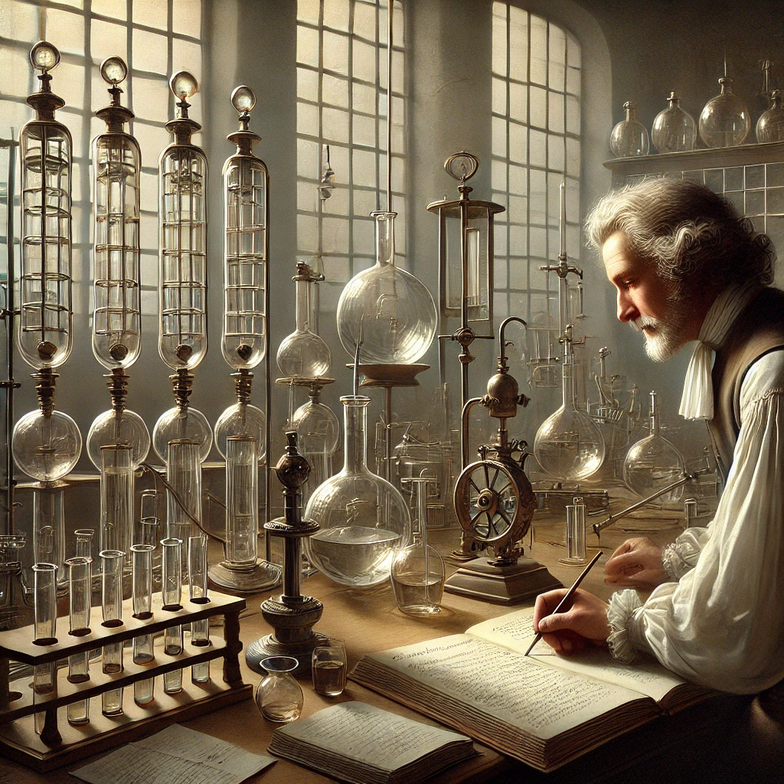
波义耳的实验室布置简洁而有序，摆放着各种玻璃器皿和自制的实验仪器。波义耳亲自操作真空泵，进行气体实验，他仔细观察实验现象，并认真记录在笔记本上。
波义耳的实验室
Scene 1: Boyle's Laboratory Setup (Environment and Mood)
Film Style: Detailed cinematic, high-definition realism.
The camera begins with an Extreme Long Shot, showing a dimly lit, orderly 17th-century laboratory. A Dolly In transitions to a Medium Shot of the room, revealing a clean workbench lined with neatly arranged glassware and self-made instruments. Rays of natural light stream in through a small window, casting soft shadows across the polished wooden surfaces. The faint sound of quills scratching and the occasional clink of glass resonates in the quiet atmosphere.
Scene 2: Boyle Operating the Vacuum Pump (Action and Focus)
Film Style: Detailed cinematic, high-definition realism.
A Close-Up captures Boyle’s hands turning the handle of a vacuum pump, the brass and glass mechanism gleaming in the light. The camera pans to his focused expression in a Medium Close-Up, his furrowed brow lit by the soft glow of a nearby lantern. The glass vessel connected to the pump reflects faint distortions as air is removed, creating a sense of tension. A Low Angle Shot emphasizes the ingenuity of the pump, showcasing its design and importance in the scene.
Scene 3: Recording Observations (Detail and Precision)
Film Style: Detailed cinematic, high-definition realism.
A Tracking Shot follows Boyle as he steps away from the apparatus and sits at a wooden desk. A Close-Up shows his hand writing detailed notes in a leather-bound journal, the ink flowing steadily onto the page. The camera shifts to an Over-the-Shoulder Shot, revealing a mix of precise diagrams and annotations. In the background, the faint bubbling of liquids and creaking of wood enhances the immersive ambiance. Soft natural and lantern lighting highlights the discipline and methodical nature of his work.
Notes:
时光流转至 17 世纪，波义耳的出现为化学带来了革命性的转变。他强调实验和观察的重要性，通过一系列精确的气体实验，质疑了传统的元素观念，提出了化学元素的科学定义，将化学从炼金术的神秘迷雾中引领出来，使其走上了科学实证的道路，《怀疑派化学家》这部著作，便是他开启化学新纪元的有力宣言。

Slide 7
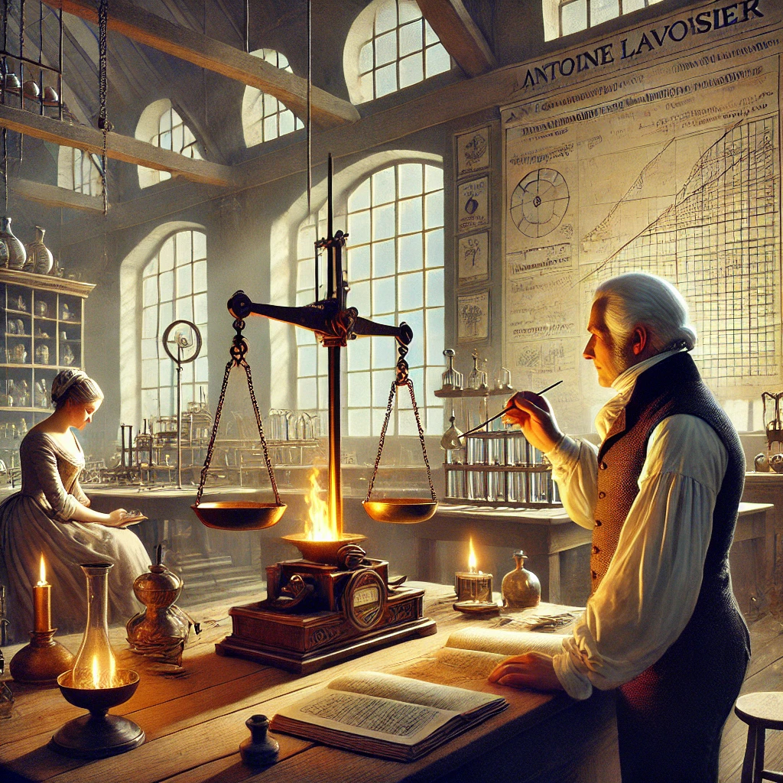
拉瓦锡以敏锐的洞察力和严谨的实验方法，掀起了化学史上的又一次重大变革。他通过定量实验，推翻了燃素说这一长期统治化学界的错误理论，建立了氧化学说，揭示了燃烧和氧化的本质。拉瓦锡还制定了化学命名法，为化学的规范化发展奠定了基础，其巨著《化学基础论》成为了后世化学家们的经典指南。
拉瓦锡《化学基础论》
Notes:
随后，拉瓦锡以敏锐的洞察力和严谨的实验方法，掀起了化学史上的又一次重大变革。他通过定量实验，推翻了燃素说这一长期统治化学界的错误理论，建立了氧化学说，揭示了燃烧和氧化的本质。拉瓦锡还制定了化学命名法，为化学的规范化发展奠定了基础，其巨著《化学基础论》成为了后世化学家们的经典指南。

Slide 8
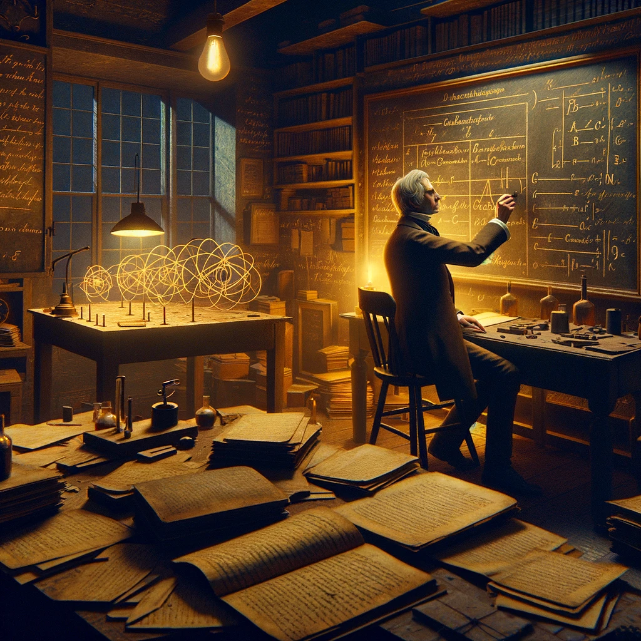
19 世纪初，道尔顿
19 世纪初，道尔顿在前人研究的基础上，提出了原子论。他认为原子是构成物质的基本微粒，具有独特的质量和性质，化学反应只是原子的重新组合。这一理论犹如一把钥匙，开启了化学定量研究的大门，解释了众多化学现象和化学反应的规律，让人们对物质世界的微观构成有了更为清晰的认识。
Notes:
19 世纪初，道尔顿在前人研究的基础上，提出了原子论。他认为原子是构成物质的基本微粒，具有独特的质量和性质，化学反应只是原子的重新组合。这一理论犹如一把钥匙，开启了化学定量研究的大门，解释了众多化学现象和化学反应的规律，让人们对物质世界的微观构成有了更为清晰的认识。

Slide 9
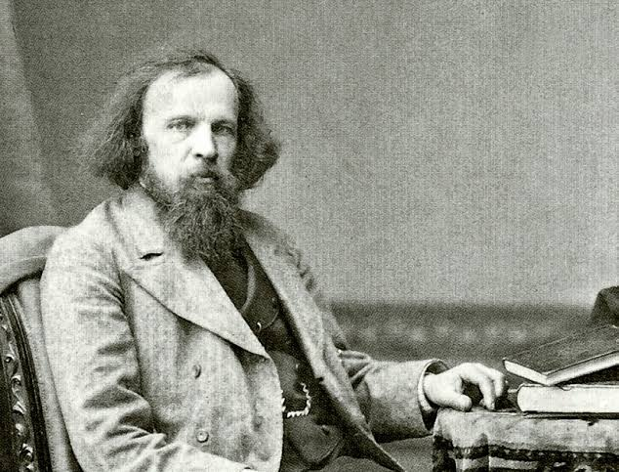
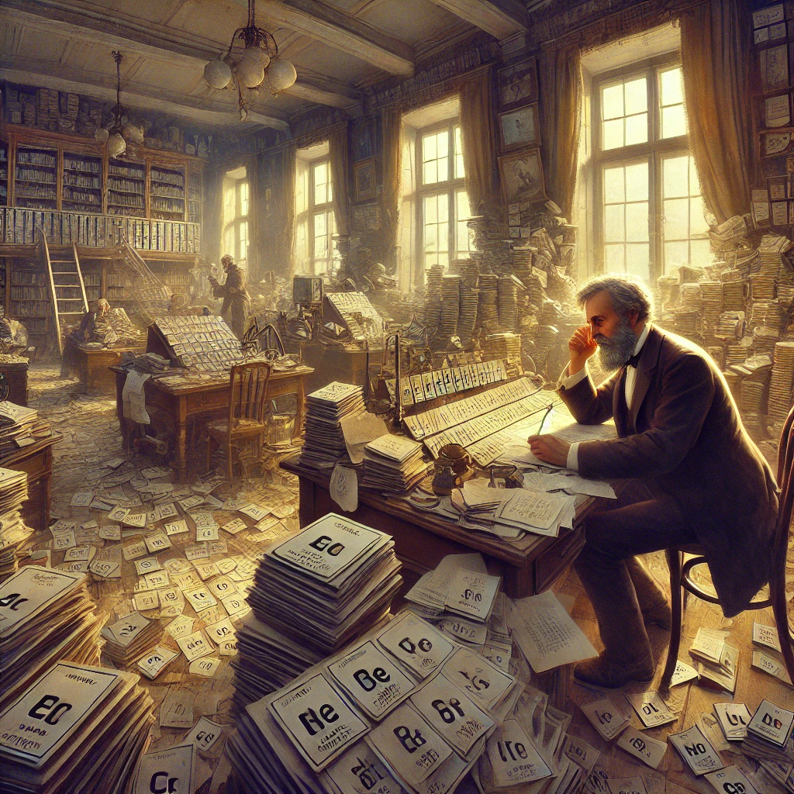
门捷列夫和元素周期表
门捷列夫在杂乱的办公室中，面对着写满元素信息的卡片，时而皱眉思考，时而快速排列卡片。突然，他的眼中闪过一丝兴奋，迅速将元素周期表的雏形绘制在纸上，随后起身激动地在房间内踱步，思考着元素周期律的深远意义。
Notes:
到了 19 世纪中叶，门捷列夫凭借着对元素性质的深刻理解和天才的直觉，发现了元素周期律，并编制出了世界上第一张元素周期表。他将元素按照原子量和化学性质进行排列，不仅成功地预测了许多未知元素的存在和性质，还为化学研究提供了一个系统的框架，使元素化学的研究变得有条不紊，极大地推动了化学学科的发展。

Slide 10
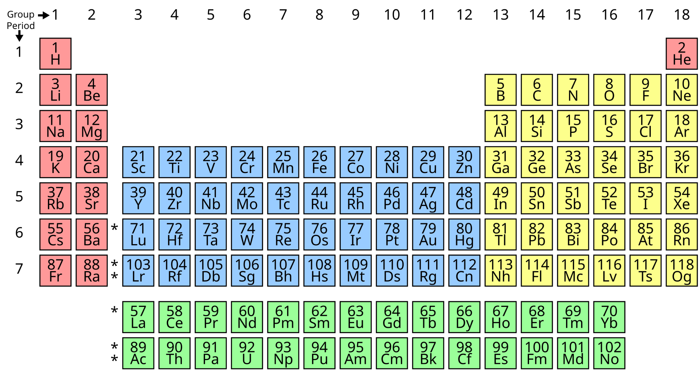
Notes:
Mani-chemistry

Slide 11
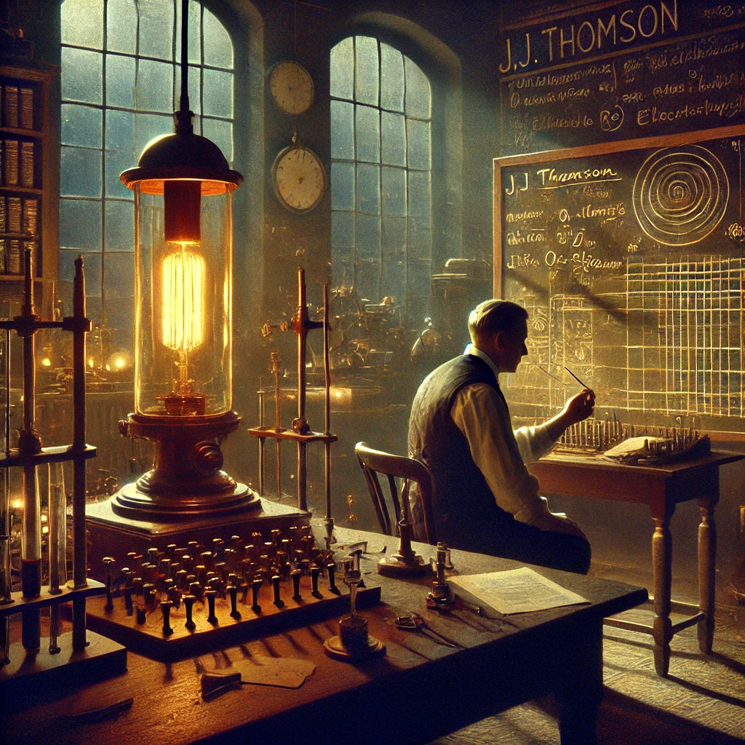
20 世纪初，汤姆逊的实验室里，阴极射线管发出神秘的荧光。汤姆逊专注地调整仪器参数，观察着阴极射线的偏转情况，旁边的黑板上写满了关于电子的计算公式和假设。|14:00 - 16:00|
Notes:
随着 20 世纪的钟声敲响，物理学的新发现为化学注入了强大的动力。汤姆逊在研究阴极射线时发现了电子，打破了原子不可再分的传统观念，揭示了原子内部的复杂结构，从此，化学家们开始深入探索原子内部的微观世界，量子化学等新兴领域也在这一时期逐渐孕育而生。

Slide 12
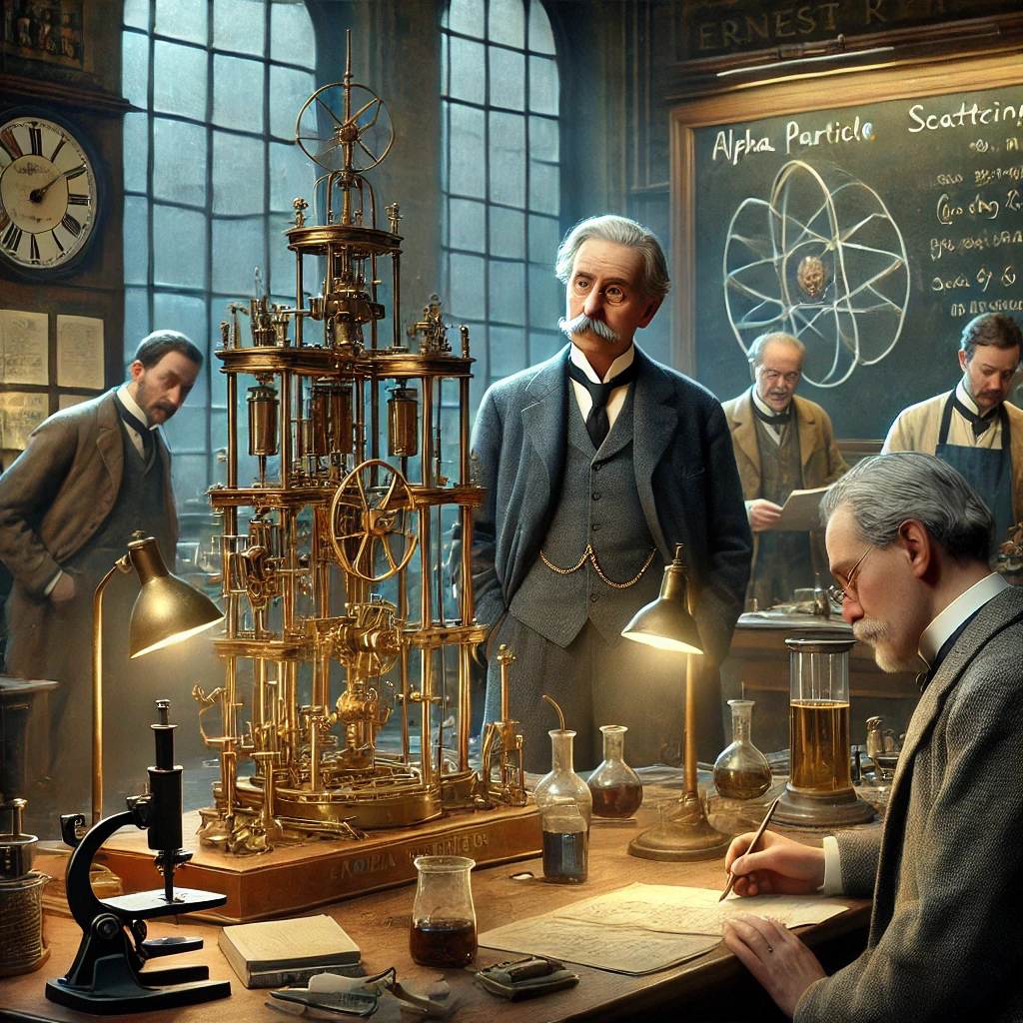
卢瑟福的实验室里，α粒子散射实验装置占据了中心位置。卢瑟福和助手们紧张地进行着实验操作，观察着闪烁屏上的亮点分布。当看到实验结果时，卢瑟福露出了惊讶而又深思的表情，随后他开始在黑板上绘制原子核式结构模型的草图，并向助手们讲解其中的原理。|16:00 - 18:00|
Notes:
紧接着，卢瑟福通过著名的α粒子散射实验，提出了原子核式结构模型，进一步揭示了原子的奥秘。他的发现为现代化学的发展奠定了坚实的基础，使化学家们对原子间的相互作用和化学键的本质有了更深入的思考，推动了化学理论向更深层次迈进。

Slide 13
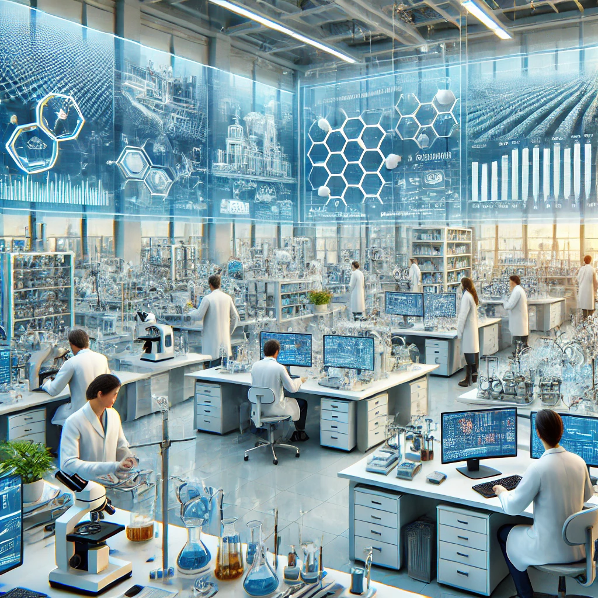
现代化学实验室宽敞明亮，摆满了各种先进的大型仪器设备，科研人员们穿着白大褂，在仪器前忙碌地操作着，电脑屏幕上不断更新着复杂的数据和分子结构模型。同时展示化学在制药、材料、能源、环保等多个领域的实际应用场景，如新型药物的研发过程、高强度复合材料的制造工艺、太阳能电池的生产流程以及污水处理厂的净化设施等。|18:00 - 20:00|
Notes:
如今，化学已发展成为一门综合性强、应用广泛的学科。从微观世界的量子化学理论研究，到宏观领域的材料合成、药物研发、能源开发与环境保护，化学的身影无处不在。化学家们借助先进的仪器设备，不断探索未知，创造新物质，解决人类面临的各种难题，为人类社会的进步与发展贡献着不可或缺的力量，化学的未来充满无限可能，等待着我们继续去探索和发现。|仪器设备的运转声，键盘敲击声，各种工业生产的背景音，激昂的现代音乐|

Slide 14
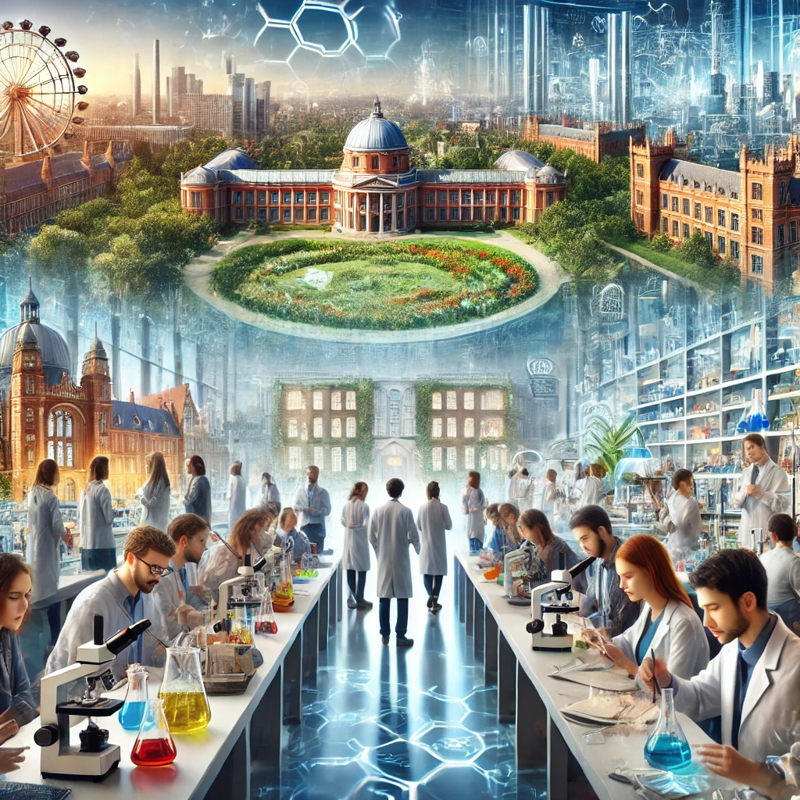
画面渐变为世界各地的著名化学研究机构、高校化学系的教学楼以及充满活力的化学学术交流会议现场，展示众多化学研究者们交流合作、共同探索的场景。最后画面定格在一群年轻的学生在现代化实验室中充满好奇与热情地进行化学实验，他们的脸上洋溢着对化学知识的渴望和对未来的憧憬。
Notes:
回顾化学的发展历程，从古代文明的初步探索，到近代科学的重大突破，再到现代科技的蓬勃发展，化学始终与人类文明的进步紧密相连。无数化学家们凭借着对真理的执着追求和创新精神，铸就了化学这一伟大科学的辉煌历史。在未来的征程中，化学将继续引领我们探索未知，创造奇迹，为人类开启更加美好的明天。

